Slide 1
Binary System
Chapter 2-1
COMP 121 Computer Architecture

Slide 2
Decimal Numbers
In general, a number with a decimal point is represented as the follows:
…a₅a₄a₃a₂a₁a₀.a₋₁a₋₂a₋₃...
a_{j} coefficients are one of the ten digits (0, 1, 2, 3, …, 9)
Base is ten,
a_{n}*10^{n}+a_{n-1}*10^{n-1}+…+a₂*10²+a₁*10¹+a₀₊
a₋₁*10⁻¹+a₋₂*10⁻²+…+ +a_{-m}*10^{-m}
E.g 7392=7*10³+3*10²+9*10¹+2*10⁰
COMP 121 Computer Architecture

Slide 3
Binary Numbers
Base is two,
a_{n}*2^{n}+a_{n-1}*2^{n-1}+…+a₂*2²+a₁*2¹+a₀₊
a₋₁*2⁻¹+a₋₂*2⁻²+…+ +a_{-m}*2^{-m}
a_{j} coefficients are one of the 2 digits (0, 1)
E.g
26.75 =11010.11
=1*2⁴+1*2³+0*2¹+0*2⁰+1*2⁻¹+1*2⁻²
COMP 121 Computer Architecture

Slide 4
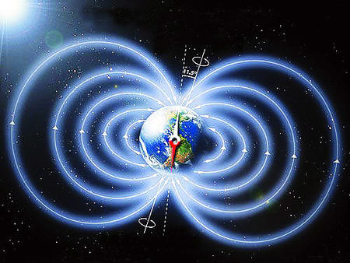
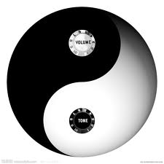

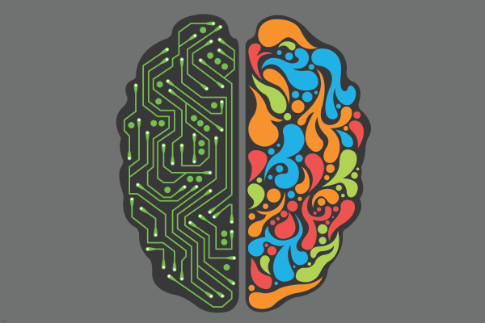
Two States in the world
COMP 121 Computer Architecture

Slide 5

Advantage of Digital Over Analog -1
1. The main advantage of digital signals over analog signals is that the precise signal level of the digital signal is not vital. This means that digital signals are fairly immune to the imperfections of real electronic systems which tend to spoil analog signals. As a result, digital CD's are much more robust than analog LP's.
COMP 121 Computer Architecture

Slide 6
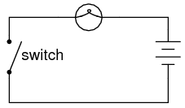
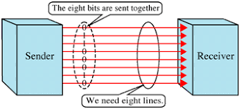
Advantage of Digital Over Analog-2
2. There is minimal electromagnetic interference in digital technology (Transistor).
3. It enables multi-directional transmission simultaneously (Parallel).
COMP 121 Computer Architecture

Slide 7
Advantage of Digital Over Analog-3
4. Codes are often used in the transmission of information. These codes can be used either as a means of keeping the information secret or as a means of breaking the information into pieces that are manageable by the technology used to transmit the code, e.g. The letters and numbers to be sent by a Morse code are coded into dots and dashes.
5. It is also easier to translate human audio and video signals and other messages into machine language.
COMP 121 Computer Architecture

Slide 8
Advantage of Digital Over Analog-4
6. Enables transmission of signals over a long distance.
7. Transmission is at a higher rate and with a wider broadband width.
8. It is more secure.
9. It is also easier to translate human audio and video signals and other messages into machine language.
COMP 121 Computer Architecture

Slide 9
Advantage of Digital Over Analog-5
10. Digital signals do not get corrupted by noise etc. You are sending a series of numbers that represent the signal of interest (i.e. audio, video etc.)
11. Digital signals typically use less bandwidth. This is just another way to say you can cram more information (audio, video) into the same space.
12. Digital can be encrypted so that only the intended receiver can decode it (like pay per view video, secure telephone etc.)
COMP 121 Computer Architecture

Slide 10
Advantage of Digital Over Analog-6
13. Digital signals can be processed by digital circuit components, which are cheap and easily produced in many components on a single chip. Again, noise propagation through the demodulation system is minimized with digital techniques.
14. Digital signals can convey information with greater noise immunity, because each information component (byte etc) is determined by the presence or absence of a data bit (0 or one). Analog signals vary continuously and their value is affected by all levels of noise.
COMP 121 Computer Architecture

Slide 11
Hexadecimal (Base 16) System
In general, a number with a hexadecimal (base-16) is represented as the follows:
a_{n}*16^{n}+a_{n-1}*16^{n-1}+…+a₂*16²+a₁*16¹+a₀₊
a₋₁*16⁻¹+a₋₂*16⁻²+…+ +a_{-m}*16^{-m}
a_{j} coefficients are one of the 16 digits (0, 1, 2, 3, …, A,
B, C, D, E, F)
E.g (B65F)₁₆=11*16³+6*16²+5*16+15
COMP 121 Computer Architecture

Slide 12
Base r System
In general, a number with a base-r is represented as the follows:
a_{n}*r^{n}+a_{n-1}*r^{n-1}+…+a₂*r²+a₁*r¹+a₀₊
a₋₁*r⁻¹+a₋₂*r⁻²+…+ +a_{-m}*r^{-m}
a_{j} coefficients are one of the r digits (0, 1, 2, 3, …, r)
E.g (4021.2)₅=4*5³+0*5²+2*5¹+1*5⁰+2*5⁻¹
COMP 121 Computer Architecture

Slide 13
Number Base Conversions
(1010.011)₂ =2³+2¹+2⁻²⁺2⁻³=(10.375)₁₀
(630.4)₈ =6*8²+3*8+4*8⁻¹=(408.5)₁₀
COMP 121 Computer Architecture

Slide 14
Complements-Decimal
The 10’s complement of (52520)₁₀ is 10⁵-52520=47480
The number of digits in the number is n=5
The 10’s complement of (25.639)₁₀ is 10²-25.639=74.361
The 10’s complement of (0.3267)₁₀ is 1-0.3267=0.6733
No integer part, so 10^{n}=10⁰=1
COMP 121 Computer Architecture

Slide 15
Complements-Binary
The 2’s complement of (1101100)₂ is 0010100
The 2’s complement of (0110111)₂ is 1001001
COMP 121 Computer Architecture

Slide 16
Subtraction with complement
1. Add the minuend M to the r’s complement of the subtrahend N.
This performs M+(r^{n}-N)=M-N+r^{n}
2. If M=>N, the sum will produce an end carry, r^{n}, which is discard; what is left is the result M-N.
3. If M<N, the sum does not produce an end carry and is equal to r^{n}-(N-M), which is the r’s complement of (N-M). To obtain the answer in a familiar form, take the r’s complement of the sum and place a negative sign in front.
COMP 121 Computer Architecture

Slide 17
Example 1-1
72532-3250=69282
M=72532
N=3250
72532
+ 96750
_________
1 69282
10‘s complement of N
Discard end carry
COMP 121 Computer Architecture

Slide 18
Example 1-2
3250- 72532=-69282 -(10’s complement of 30718)
M=3250
N=72532
03250
+ 27468
_________
30718
10‘s complement of N
no carry
-(10‘s complement of 30718)=-69282
COMP 121 Computer Architecture

Slide 19
Example 1-3
1010100 -1000011=0010001
M=1010100
N=1000011
1010100
+ 0111101
_________
1 0010001
2‘s complement of N
Discard end carry
COMP 121 Computer Architecture

Slide 20
Example 1-4
1000011 - 1010100 =-0010001
M=1000011
N= 1010100
1000011
+ 0101100
_________
1101111
2‘s complement of N
No end carry
-(2‘s complement of 1101111)=-0010001
COMP 121 Computer Architecture

